Slide 1
PLACEMENTS
2016
Faculty of Computer Science & Applications

Slide 2
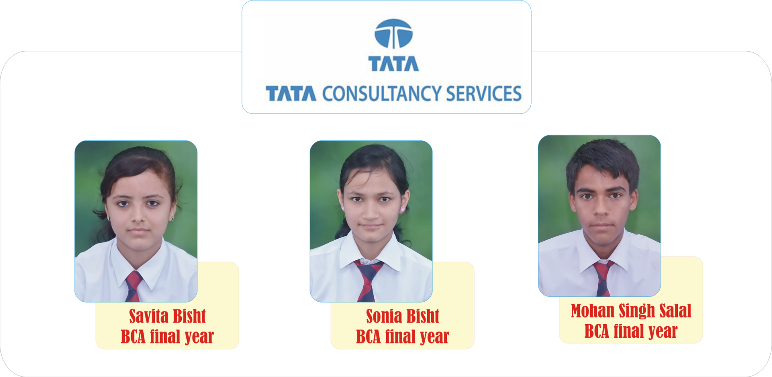
BCA
2016

Slide 3
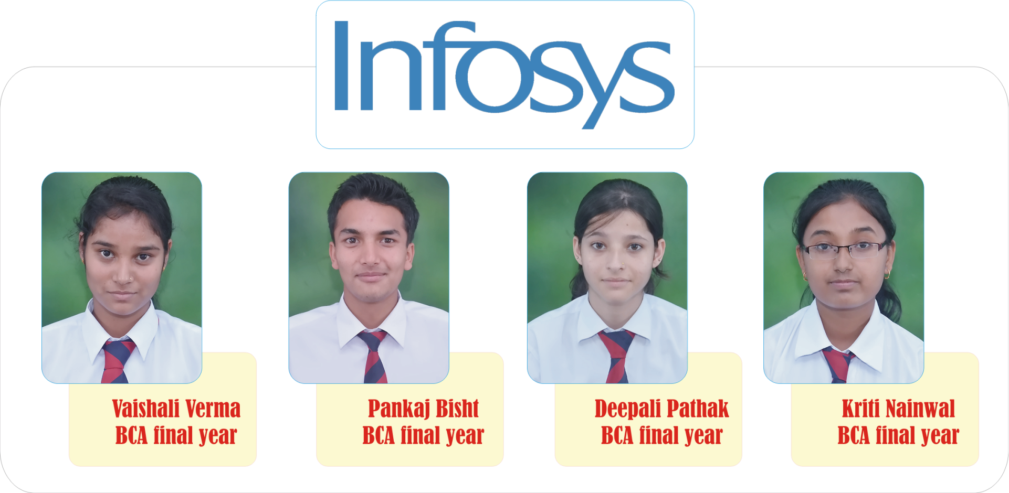
BCA
2016

Slide 4
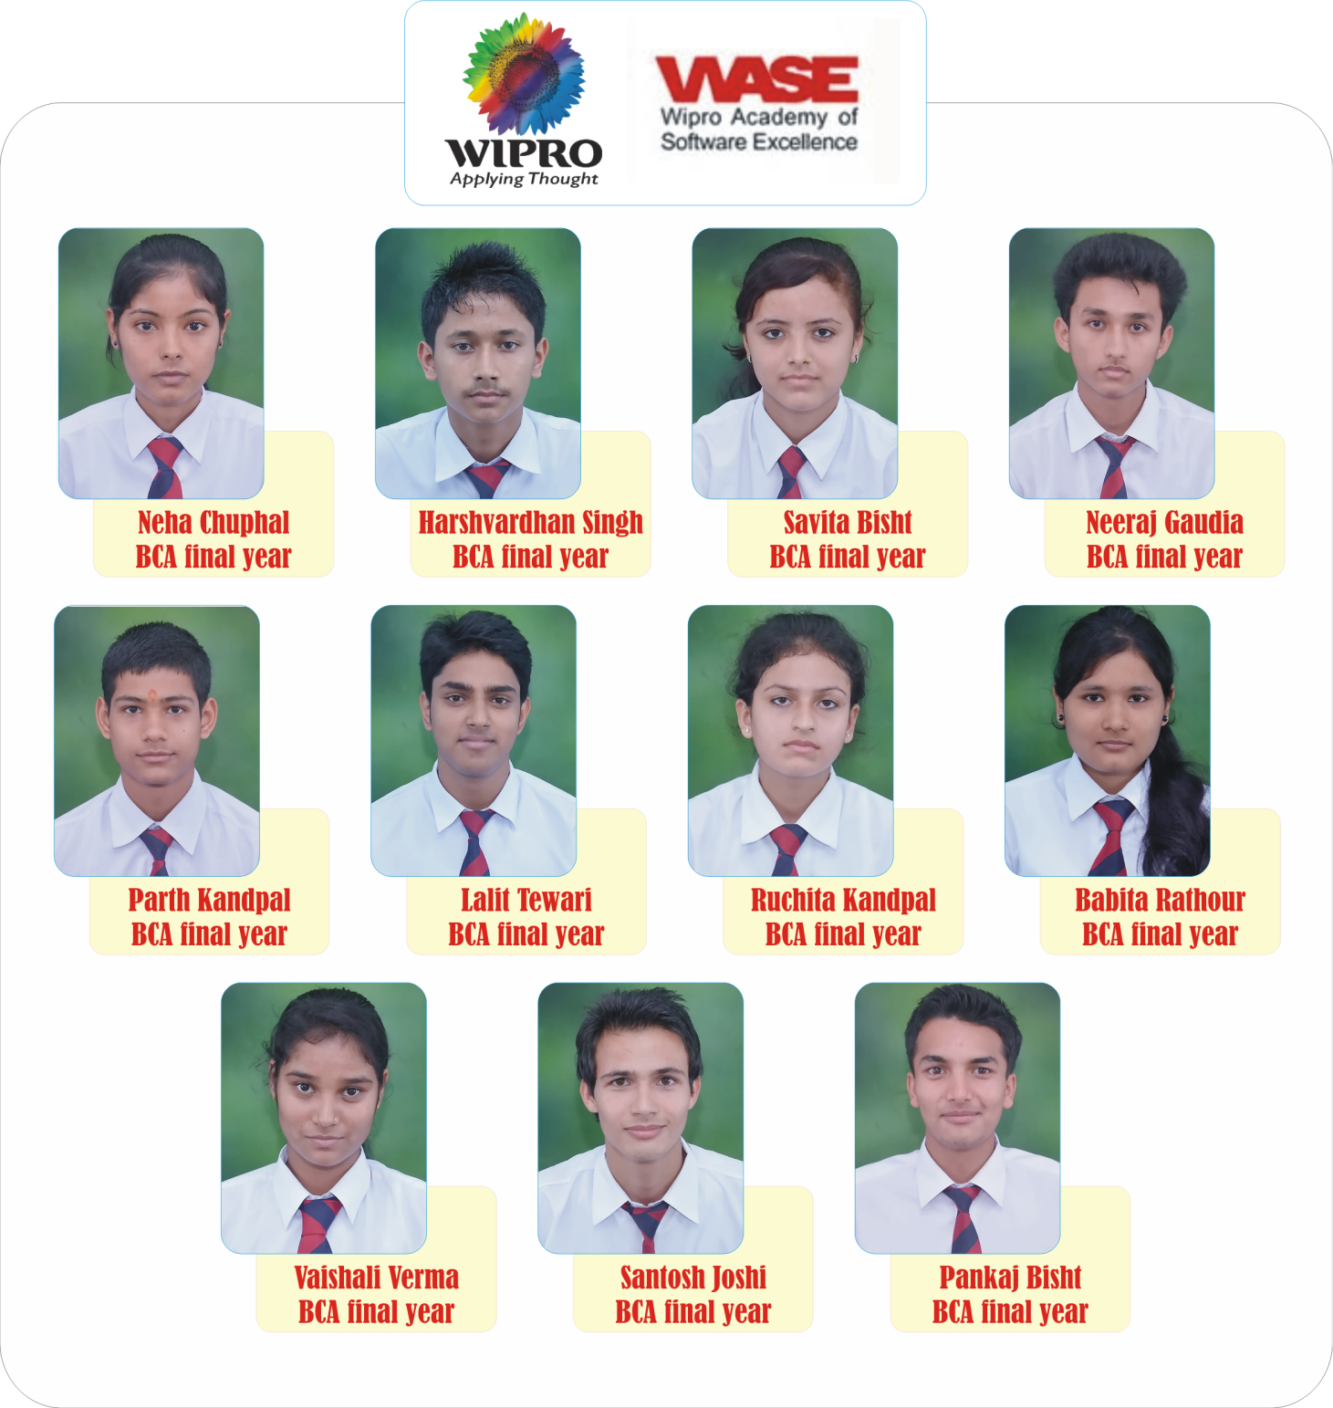
BCA
2016

Slide 5
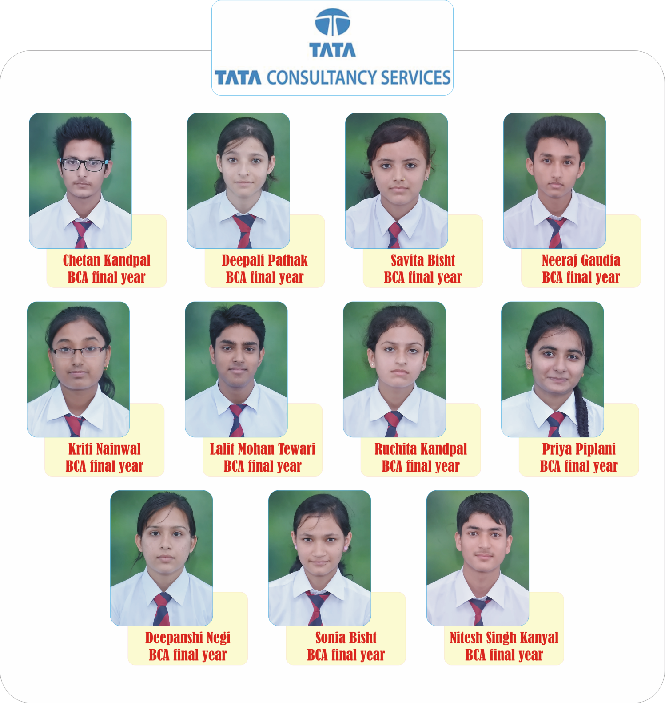
BCA
2016

Slide 6
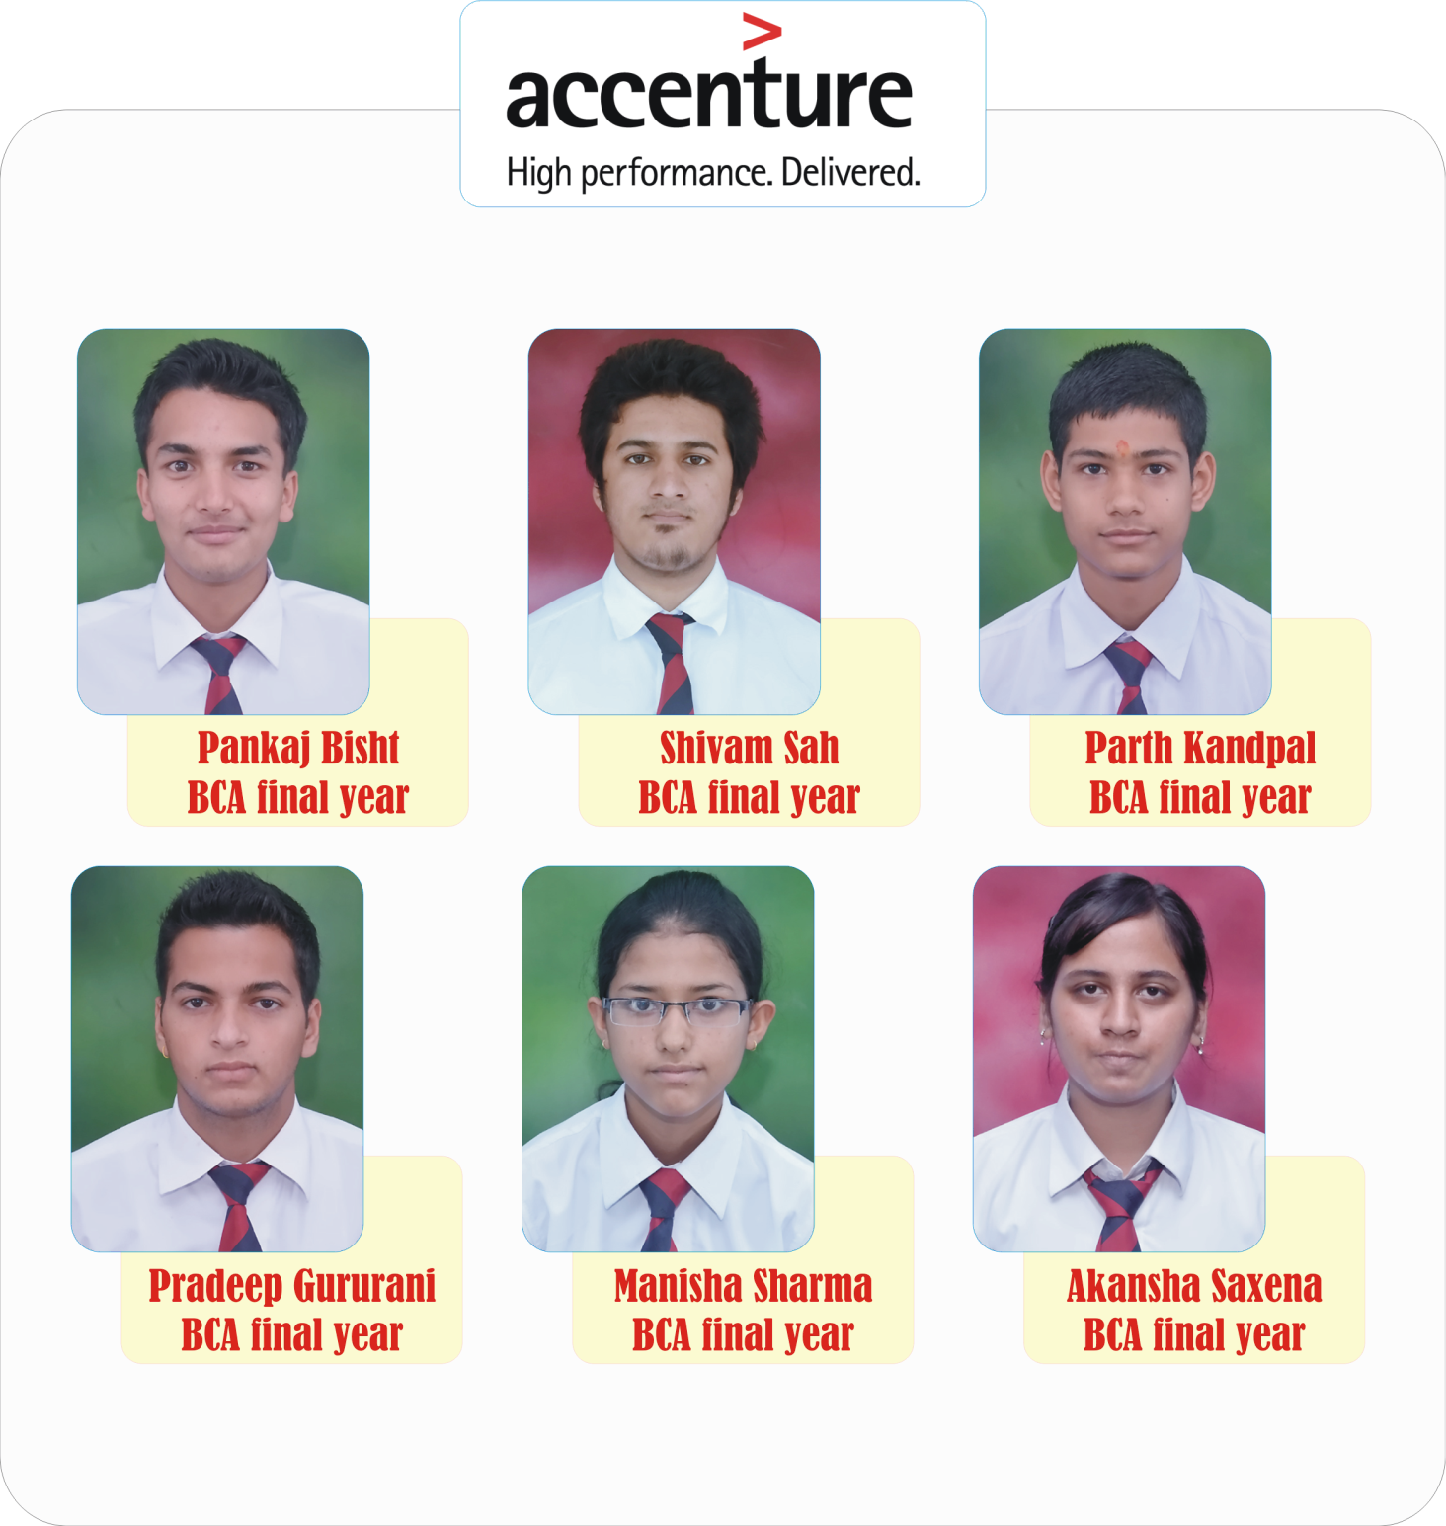
BCA
2016

Slide 7
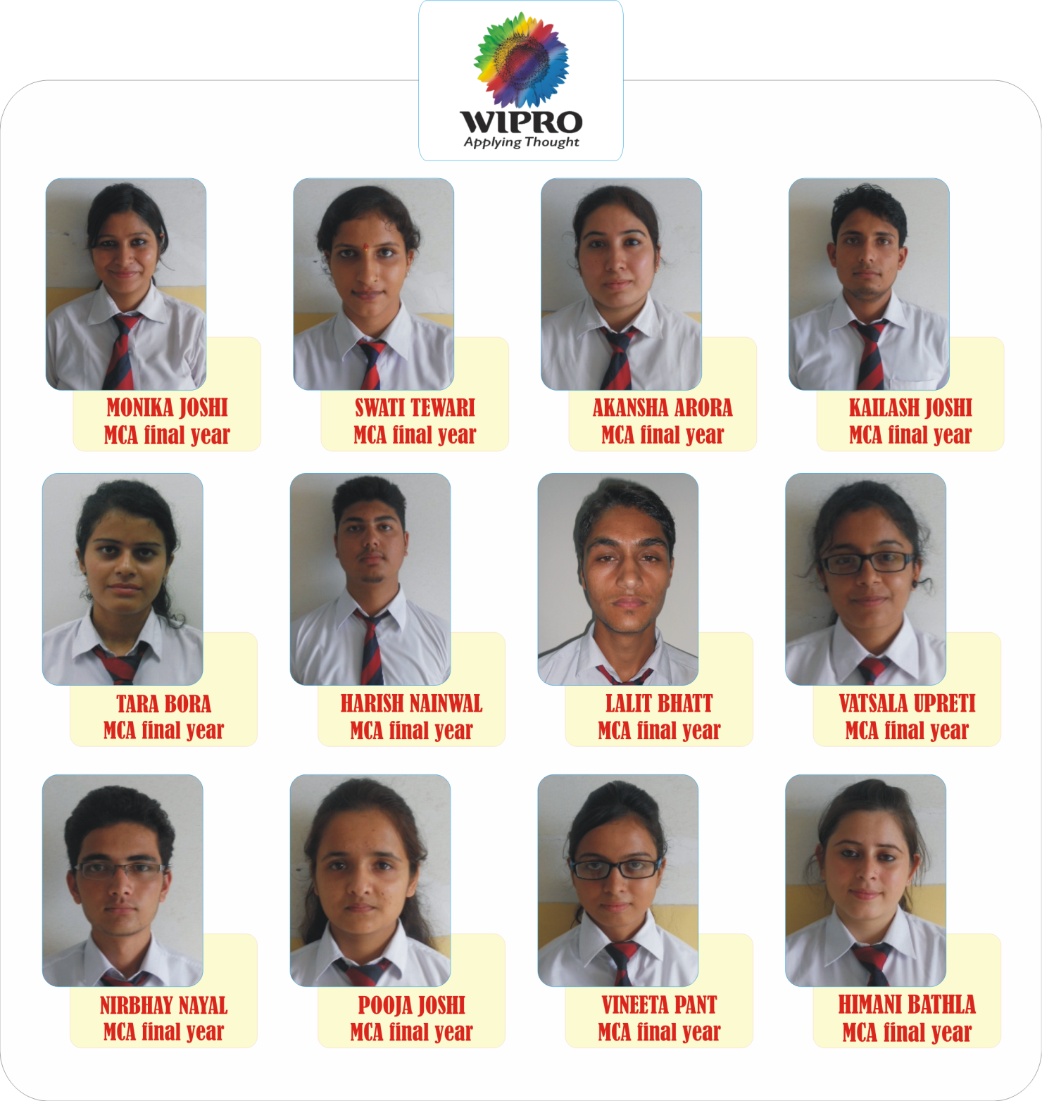
MCA
2016

Slide 8
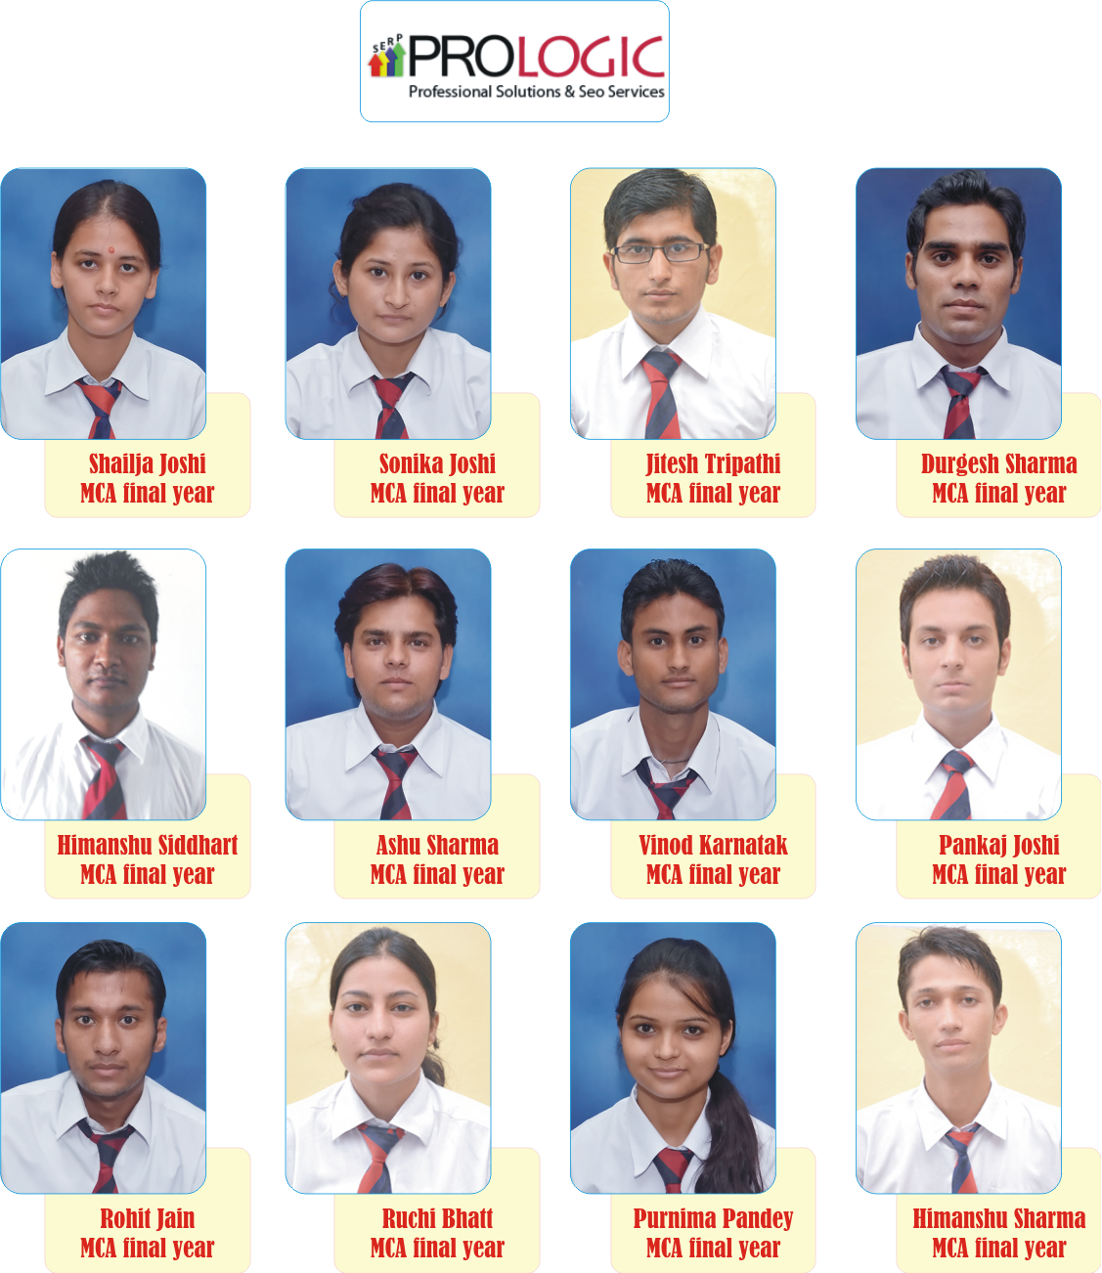
MCA
2016

Slide 9
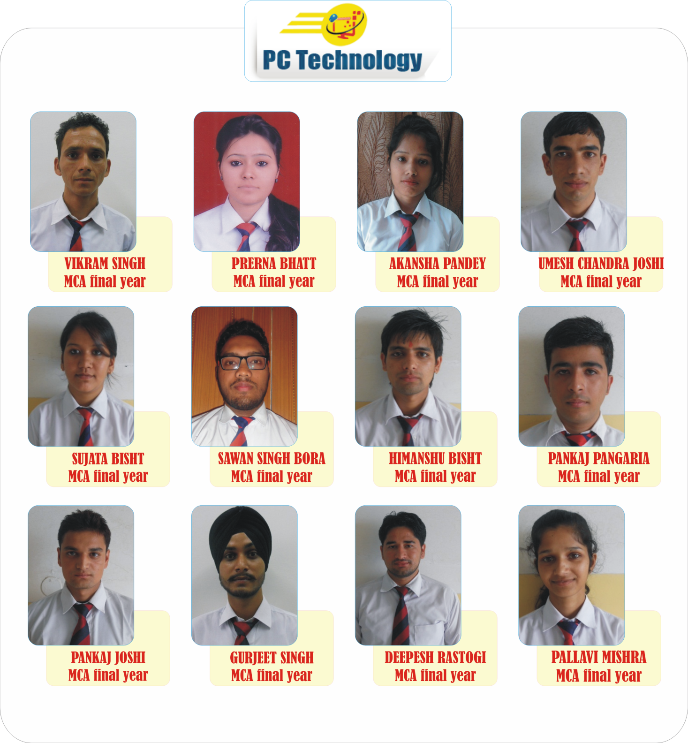
MCA
2016

Slide 10
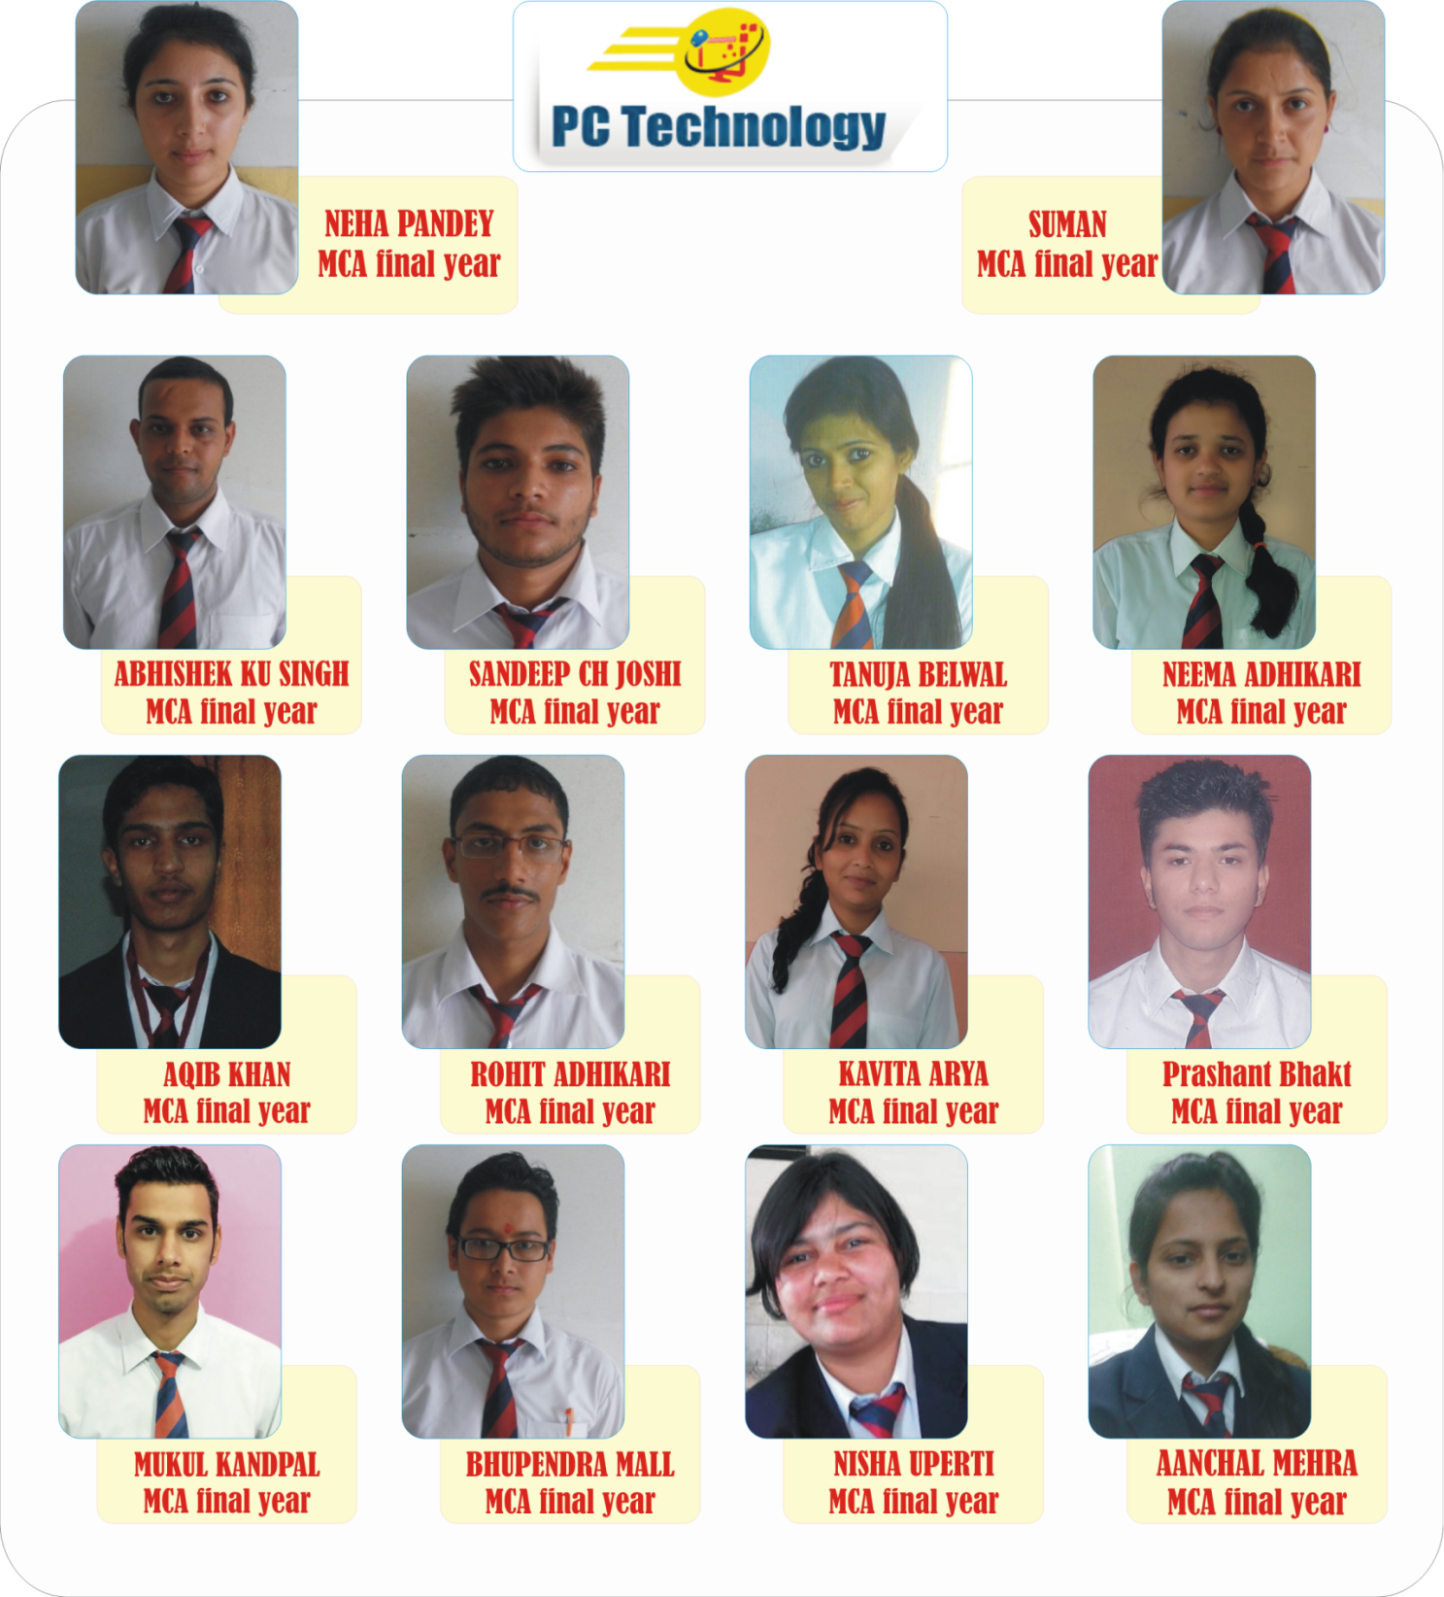
MCA
2016

Slide 11
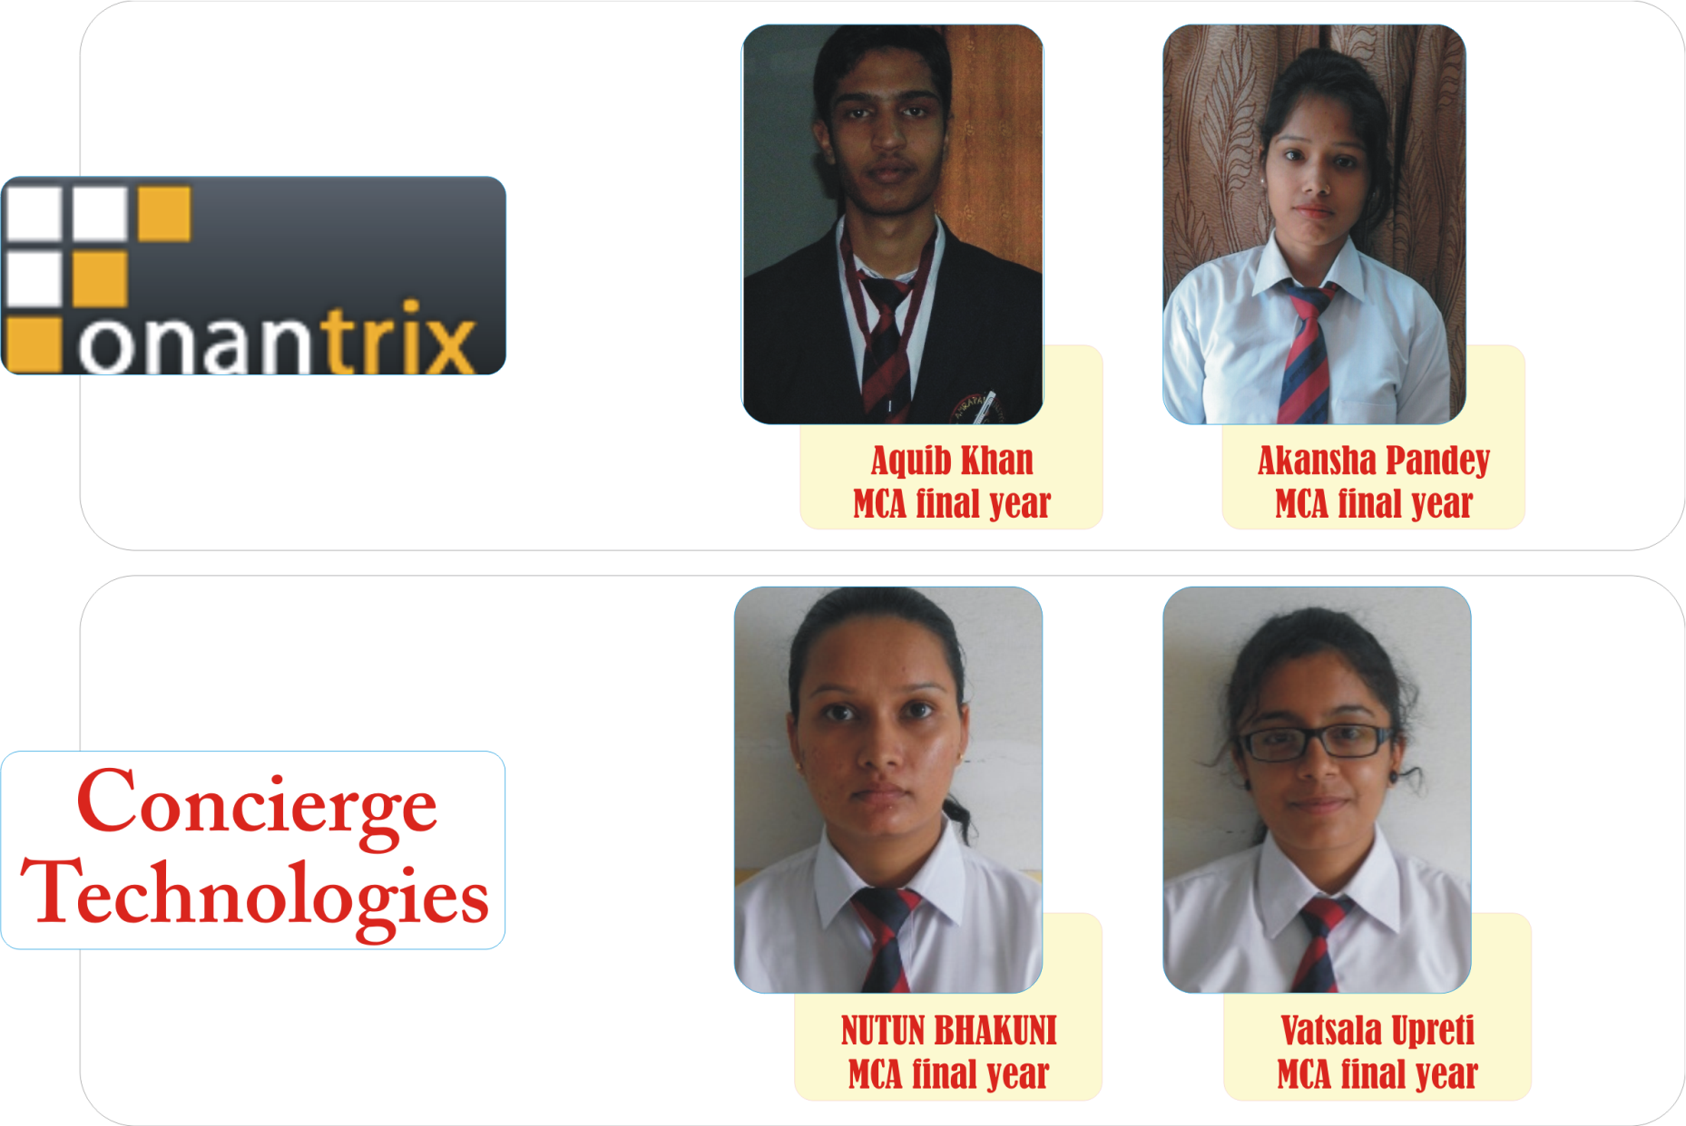
MCA
2016

Slide 12
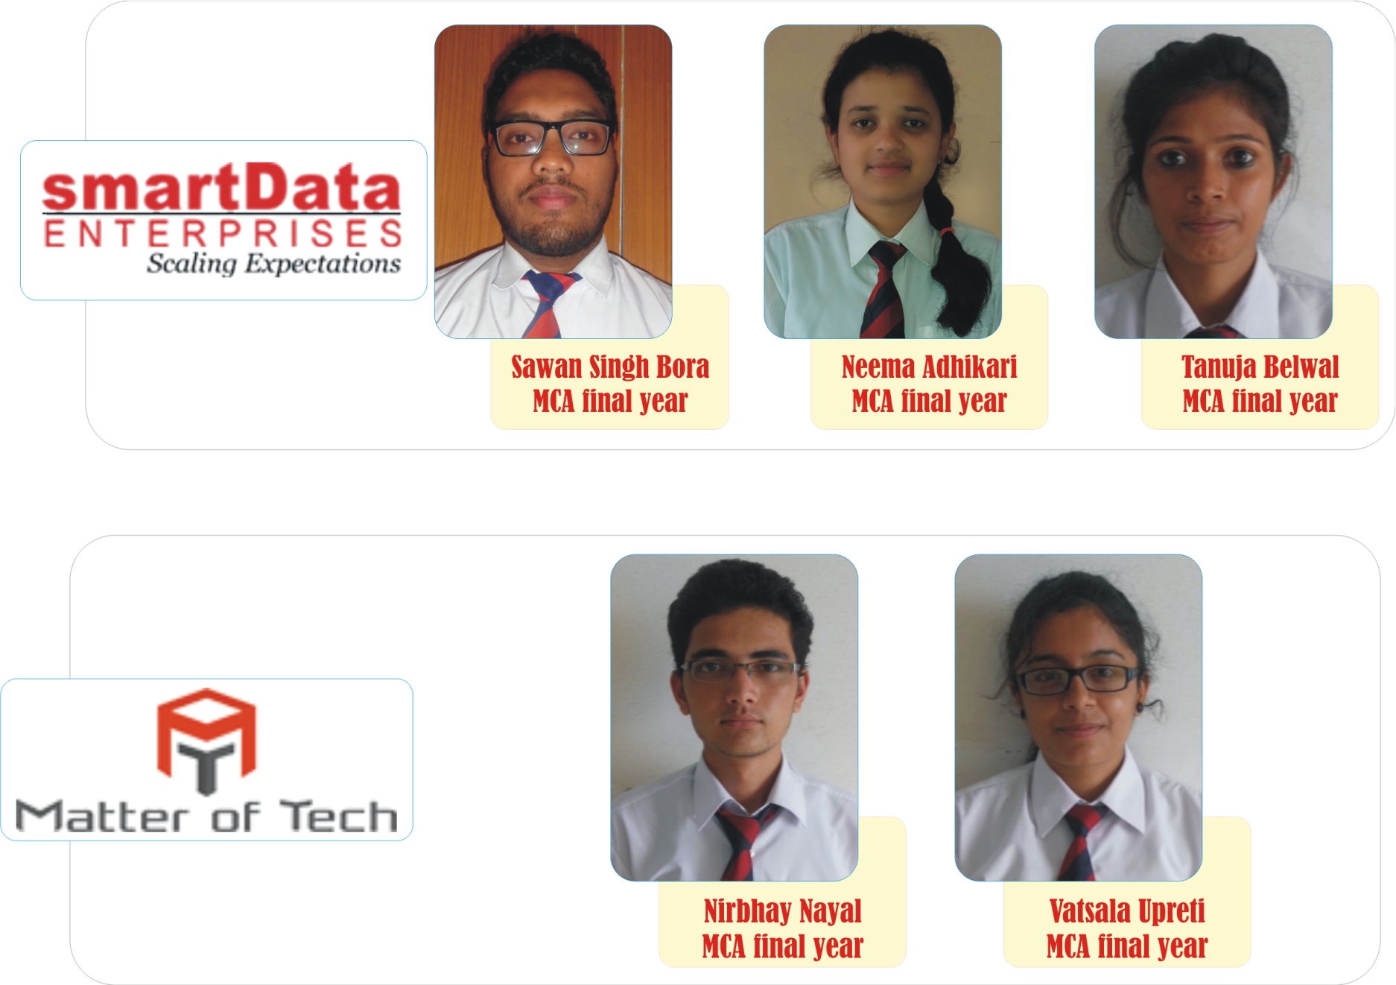
MCA
2016

Slide 13
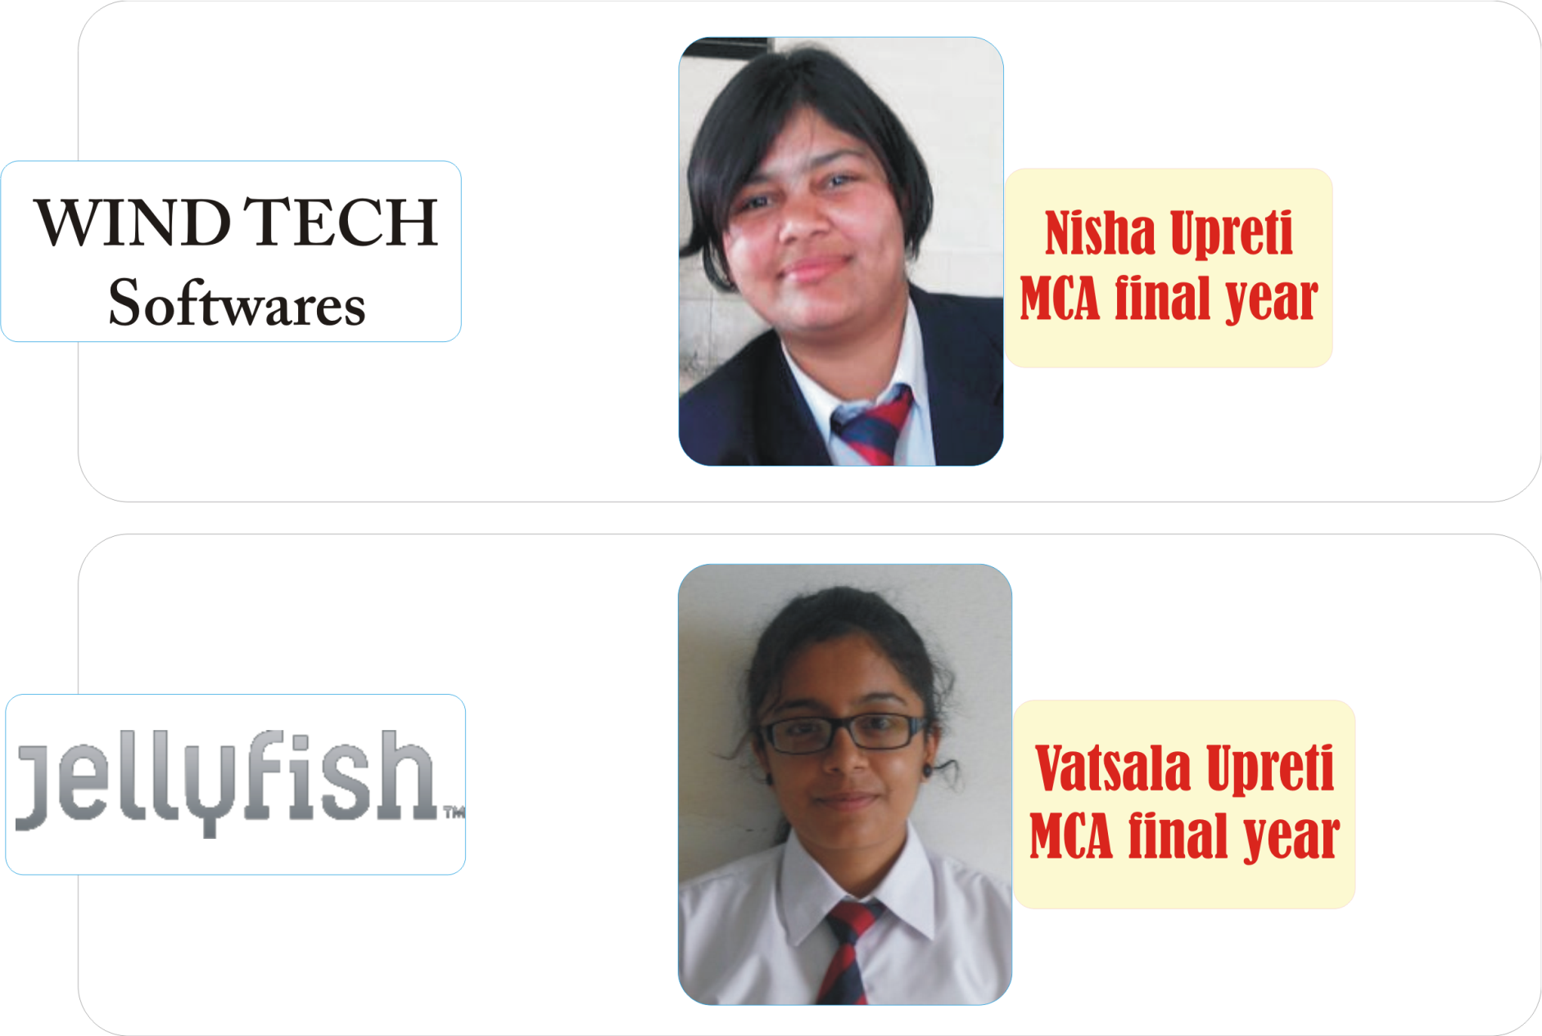
MCA
2016

